Slide 1

Dropdown, File Upload, Actions - 14
Orion Innovation
Company Overview

Slide 2
Previous Lesson’s Highlights
WAITS
1.Implicit Wait: A global timeout for all elements on the page.
driver.getdriver().manage().timeouts().implicitlyWait(Duration.ofSeconds(10));
2. Explicit Wait: Mostly used for a specific condition expected for certain elements.
WebDriverWait wait = new WebDriverWait(driver, Duration.ofSeconds(10));
wait.until(ExpectedConditions.elementToBeClickable(element));
wait.until(ExpectedConditions.visibilityOfElementLocated(By.id("username")));
Source: [1] Implicit and Explicit Waits

Slide 3
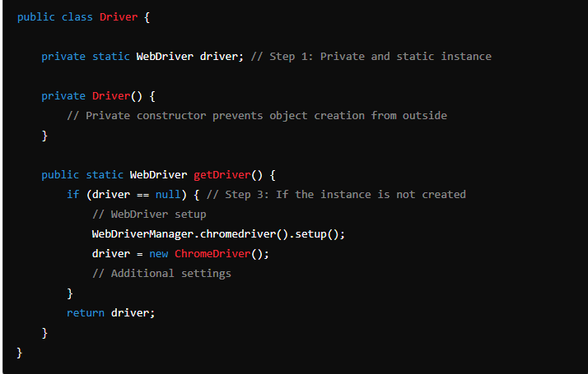
Previous Lesson’s Highlights
Driver Util (Singleton Driver Class)
Source: [1] Driver Util Class

Slide 4
Content
Dropdown Menus
File Upload
Actions

Slide 5
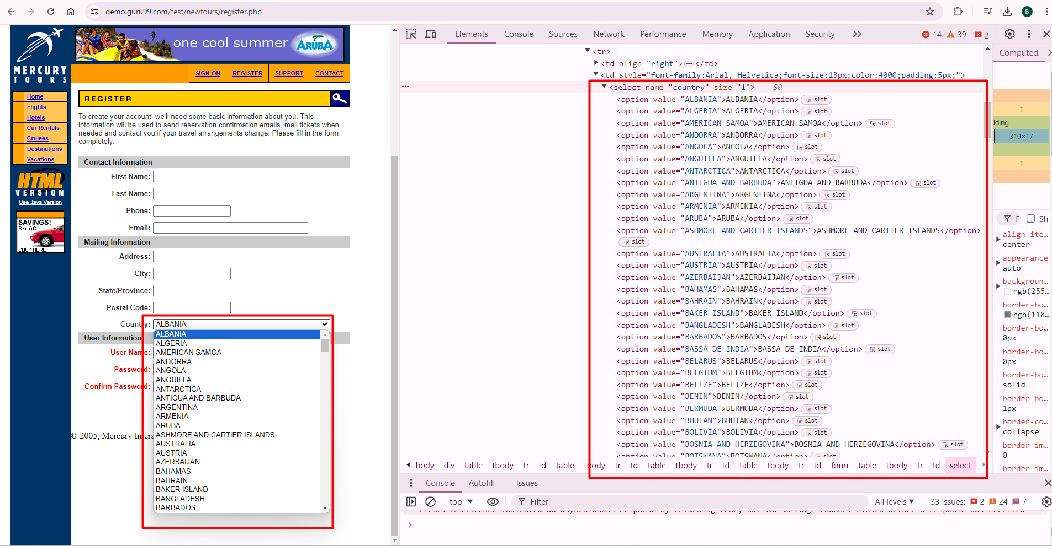
DROPDOWN
Source: [2] Dropdown List

Slide 6
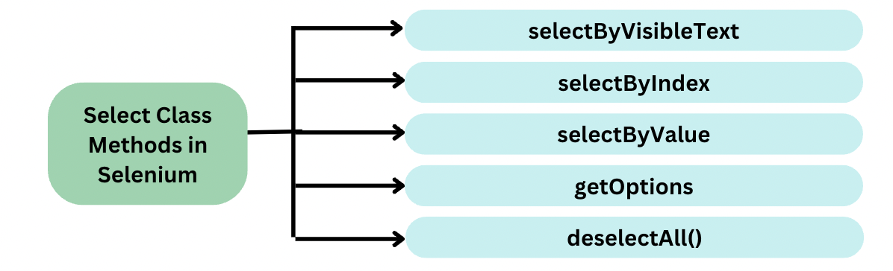
Handle Select Dropdown in Selenium
Source: [3] Handle of selecting the dropdown items

Slide 7
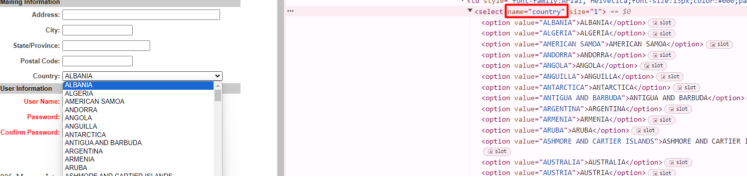
selectByVisibleText() and deselectByVisibleText():
Selects/deselects the option that displays the text matching the parameter.
Select drpCountry = new Select(driver.findElement(By.name("country")));
drpCountry.selectByVisibleText("ALBANIA");
Source: [4] Country DropDown

Slide 8

2) selectByValue() and deselectByValue():
Selects/deselects the option whose “value” attribute matches the specified parameter.
Remember that not all drop-down options have the same text and “value”, like in the example below.
Select drpCountry = new Select(driver.findElement(By.name("country")));
drpCountry.selectByValue(“1");
Source: [4] Country DropDown

Slide 9
3) selectByIndex() and deselectByIndex()
Selects/deselects the option at the given index.
Select drpCountry = new Select(driver.findElement(By.name("country")));
drpCountry.selectByIndex(0);
Source: [4] Country DropDown

Slide 10
4) isMultiple()
Returns TRUE if the drop-down element allows multiple selections at a time; FALSE if otherwise.
Example
if (drpCountry.isMultiple())
{
//do something here
}
Source: [4] isMultiple() Method

Slide 11
5) deselectAll()
Clears all selected entries. This is only valid when the drop-down element supports multiple selections.
Example
Select drpCountry = new Select(driver.findElement(By.name("country")));
drpCountry.deselectAll();
Source: [4] deselectAll() Method

Slide 12
How to Select Dropdown in Selenium without select tag?
Drop downs in a website could be created in several different ways. Some dropdowns are created using <select> HTML tag and some others are created using <ul> ,<li>, <button> and <div> tags.
By storing all the options in List and iterating through it
By creating Custom Locator and without iterating the List
By using JavaScriptExecutor class
By using sendKeys
By using Actions Class
Source: [5] Selecting DropDown items in Selenium without select tag

Slide 13
FILE UPLOAD
File upload is performed when there is a need of uploading any file or a document on a specific website such as forms, registration pages, document uploaders, etc.
Uploading a file process includes browsing a file from the desired location or from your computer and uploading it to the website.
Source: [6] Definition of File Upload

Slide 14
File Upload Types
sendKeys() method
Robot class
Using AutoIT tool
Using SetFileDetector() Method

Slide 15
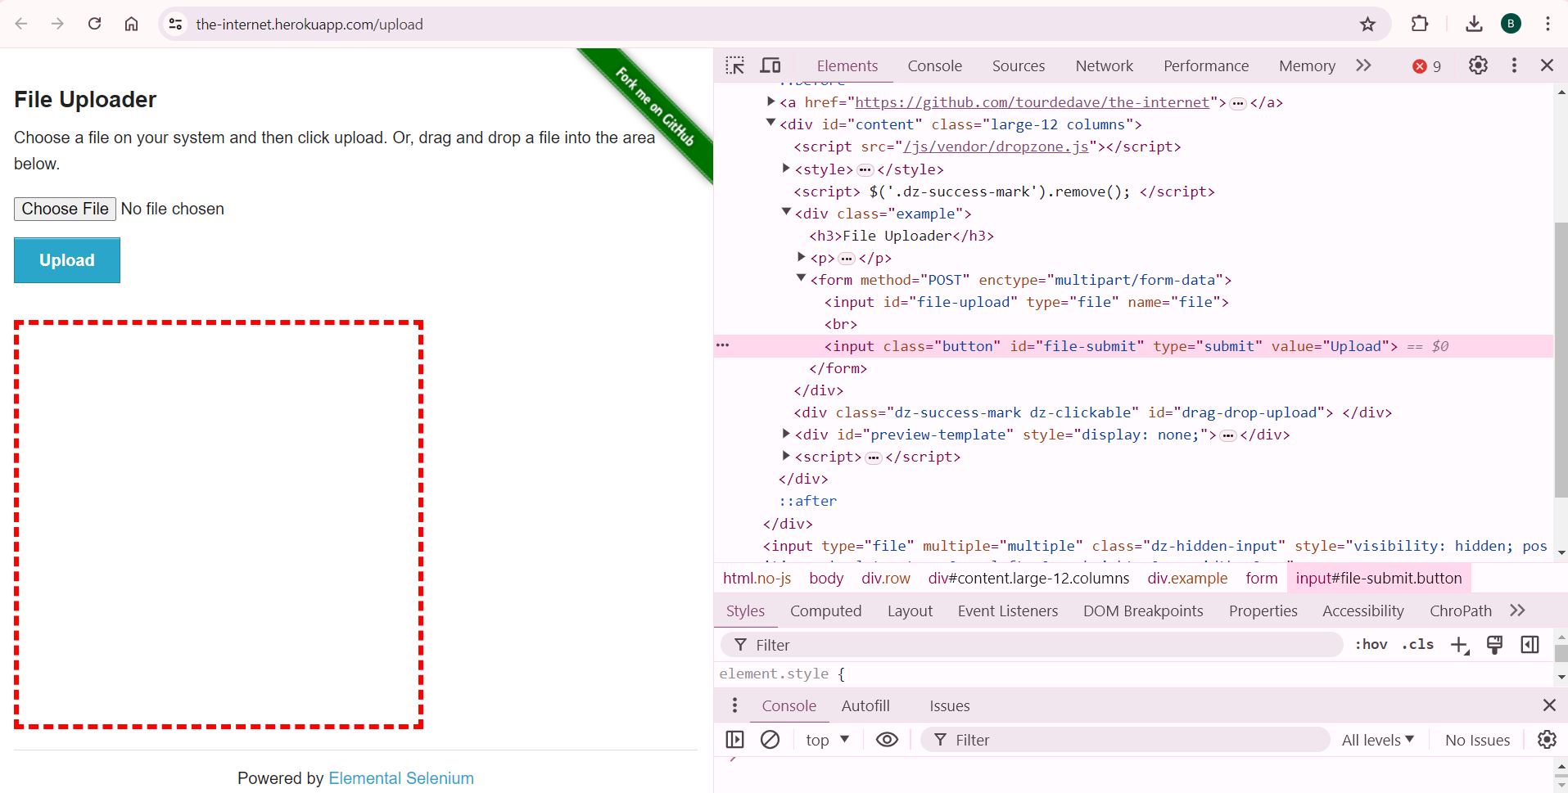
File Upload – sendKeys() Method
"Choose File" button is located.
File path is written as the value of the input of the located web element.
Source: [7] sendKeys() Method

Slide 16
File Upload – Robot Class
The Robot class in Java can be used to simulate keyboard and mouse events, including file uploads.
When we Need Robot Class?
When the user needs to handle alert pop-ups on a webpage, or
User needs to enter text on the pop-ups with a combination of modifier keys such as Alt, Shift, etc.
User wants to capture screenshot of webpage
User wants to upload/download file
Source: [8] Definition of Robot Class

Slide 17
Commonly used methods in Robot Class:
.createMultiResolutionScreenCapture(Rectangle screenRect)
.createScreenCapture(Rectangle screenRect)
.delay(int ms)
.equals(Object obj)
.getAutoDelay()
.getPixelColor(int x,int y)
.keyPress(int keycode)
.keyRelease(int keycode)
.mouseMove(int x,int y)
.mousePress(int buttons)
.mouseRelease(int buttons)
.mouseWheel(int wheelAmt)
.notify()
.setAutoDelay(int ms)
.toString()
.wait()
Source: [8] Methods in Robot Class

Slide 18
Keyboard Actions
1) KeyPress(): This method is called when you want to press any key
//To press down arrow key on the Keyboard
robot.keyPress(KeyEvent.VK_DOWN);
//To press Enter key
robot.keyPress(KeyEvent.VK_ENTER);
//To press the TAB key of keyboard
robot.keyPress(KeyEvent.VK_TAB);
//To press CAPS Lock key
robot.keyPress(keyEvent.VK_CAPS_LOCK);
//To press Up key
robot.keyPress(keyEvent.VK_UP);
2) KeyRelease(): This method is used to release the pressed key on the keyboard
//The below code is used to release the Shift Key
robot.keyRelease(KeyEvent.VK_SHIFT);
Source: [8] Keyboard Actions in Robot Class

Slide 19
Mouse Actions
1) MouseMove(): This method is used to move the mouse pointer from the current position to the X and Y intersection point. It takes the x and y coordinates as its parameters
//This moves to mouse to the x and y position
robot.mouseMove(coordinates.getX(), coordinates.getY());
robot.mouseMove(640, 360);
2) MousePress(): This method is used to press the mouse button.
//// This will press Left mouse button
robot.mousePress(InputEvent.BUTTON1_DOWN_MASK)
3) MouseRelease(): This method is used to release the mouse button.
//This will releases right mouse button
robot.mouseRelease(InputEvent.BUTTON3_DOWN_MASK);
4) MouseWheel(): This method rotates the scroll wheel of the mouse on wheel-equipped mode
//This will move the mouse scroll
robot.mouseWheel(int wheelAmt);
robot.mouseWheel(100);
Source: [8] Mouse Actions in Robot Class

Slide 20
Example of Robot Usage on File Upload
Let us see an example to upload file using Robot Class using below steps:
Step 1:Create an Object for the respective browser using WebDriver
Step 2: Navigate to the URL of the corresponding webpage
Step 3: Find the element on the web page using the element locators
Step 4: To handle the pop-ups we use Robot class, using this we create an instance of Robot Class in the code say Robot robot = new Robot().
Step 5: Store the path of the file to be uploaded using StringSelection Class Object
Step 6: Copy the above path to Clipboard
Step 7: Press Control&V to paste the above path and Release Control & V buttons
Step 8: Press Enter key and Release the same
Step 9: Wait for the file to get uploaded
Source: [8] Automation of File Upload with Robot Class

Slide 21
Using AutoIT Tool
AutoIT is a freeware and an open-source automation tool for Windows operating system.
It is written in a BASIC scripting computer language for automating the Microsoft Windows user interface.
It simulates any combination of keystrokes, mouse movements, and windows control manipulation.
AutoIT Installation Link:
https://www.autoitscript.com/site/autoit/downloads/
AutoIT More Information:
https://www.softwaretestinghelp.com/autoit-tutorial-to-download-write-autoit-script/
Source: [6] File Upload with AutoIT Tool

Slide 22
Using AutoIT Tool
Advantages of AutoIT:
AutoIT is an open-source tool for which we do not need to pay.
Small standalone executables can be created using AutoIT.
It supports easy to record or playback scripting.
We can debug the code easily with console write command.
It has the option to create different GUIs and recognizes almost all basic Windows controls.
It is simple and user-friendly.
Disadvantages of AutoIT:
It works only in Windows operating system
As fundamental coding principles knowledge is a must, it proves to be a great tool for professionals but might be a bit complicated for beginners.
AutoIT does not have Java support available so far.
The users need to import separate libraries while using different predefined utility functions.
Source: [6] Advantages and Disadvantages of AutoIT Tool

Slide 23
SetFileDetector() Method
What is File Detector?
A mechanism in Selenium WebDriver to handle file uploads when tests are executed on a remote machine.
Why Use File Detector?
Local file paths don't work with remote servers.
Allows seamless file upload operations in remote environments.
Source: [1] SetFileDetector() Method

Slide 24
Steps for SetFileDetector() Method
Step 1: Set Up the Remote WebDriver
WebDriver driver = new RemoteWebDriver(new URL("http://localhost:4444/wd/hub"), new ChromeOptions());
Step 2: Enable File Detector
((RemoteWebDriver) driver).setFileDetector(new LocalFileDetector());
Step 3: Locate the File Upload Element
WebElement uploadElement = driver.findElement(By.id("upload"));
Step 4: Upload the File
uploadElement.sendKeys("/path/to/local/file.txt");
Source: [1] Steps of SetFileDetector() Method

Slide 25
ACTIONS
During test automation, it allows you to perform all operations that you can do with the mouse and keyboard.
Example:
Actions action = new Actions(driver);
action.moveToElement(element).click().perform();
Source: [9] Actions Class

Slide 26
Methods of Action Class
Mouse Actions in Selenium:
doubleClick(): Performs double click on the element
clickAndHold(): Performs long click on the mouse without releasing it
dragAndDrop(): Drags the element from one point and drops to another
moveToElement(): Shifts the mouse pointer to the center of the element
contextClick(): Performs right-click on the mouse
Keyboard Actions in Selenium:
sendKeys(): Sends a series of keys to the element
keyUp(): Performs key release
keyDown(): Performs keypress without release
Source: [9] Methods for Actions Class

Slide 27
References
[1] https://chatgpt.com/
[2] https://demo.guru99.com/test/newtours/register.php
[3] https://www.browserstack.com/guide/select-class-in-selenium
[4] https://www.guru99.com/select-option-dropdown-selenium-webdriver.html
[5] https://www.browserstack.com/guide/handling-dropdown-in-selenium-without-select-class
[6] https://www.softwaretestinghelp.com/file-upload-in-selenium/
[7] https://the-internet.herokuapp.com/upload
[8] https://www.numpyninja.com/post/a-detailed-guide-on-how-to-do-file-upload-by-keyboard-mouse-actions-using-robot-class
[9] https://www.browserstack.com/guide/action-class-in-selenium

Slide 28
Thanks

